Slide 1
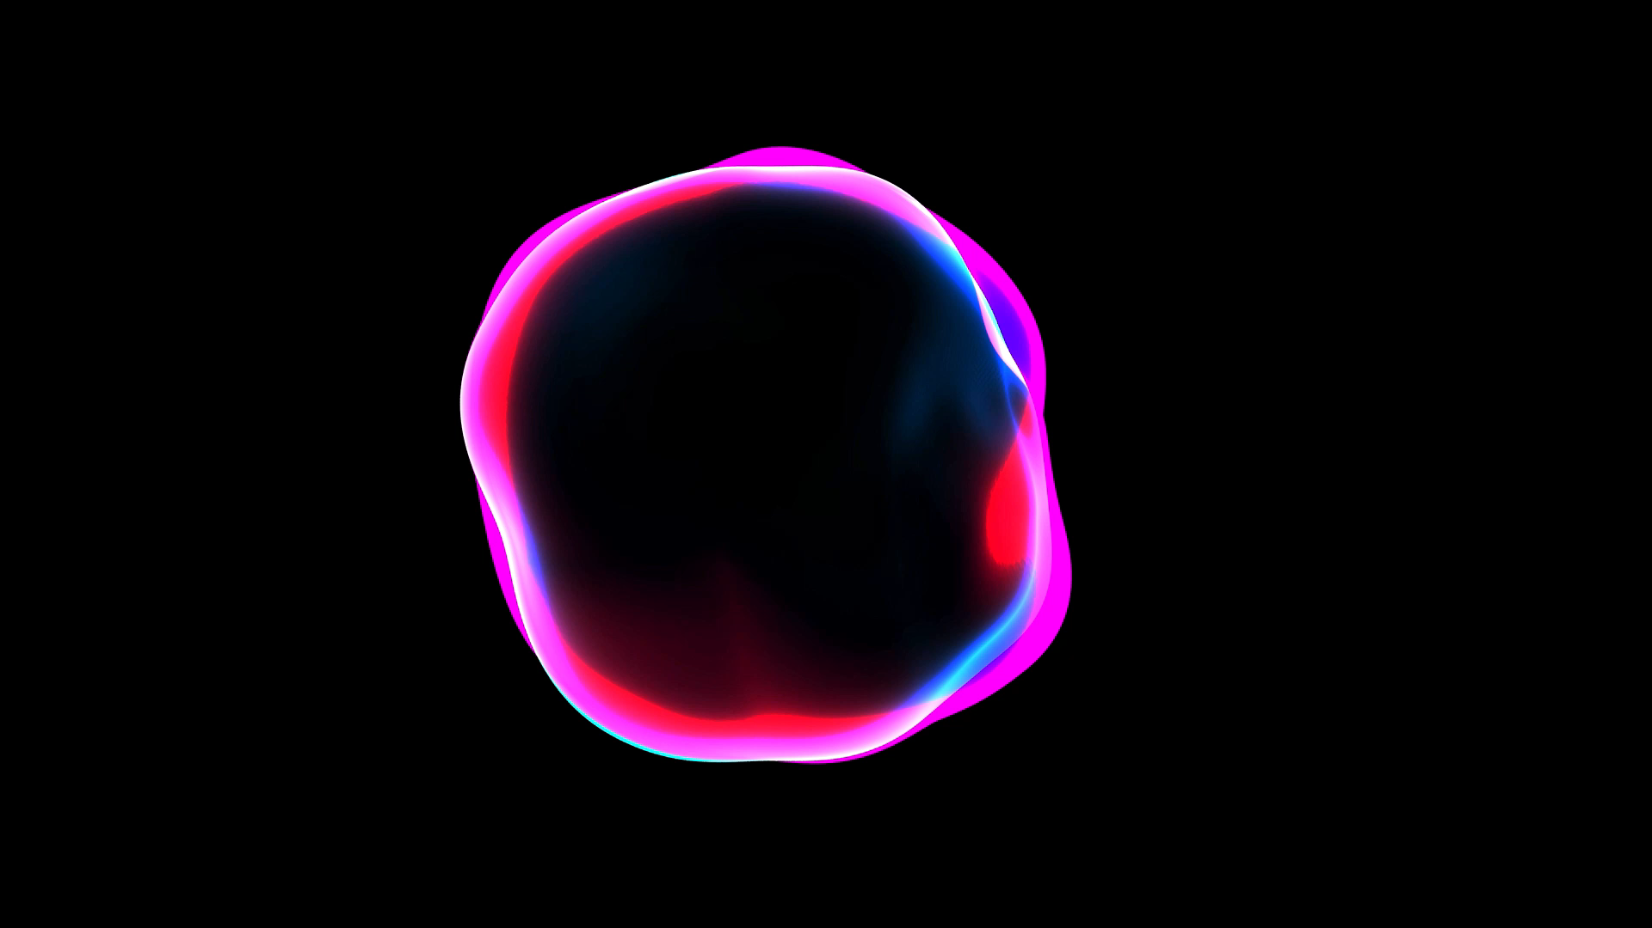
Retinal Vessel Segmentation

Slide 2
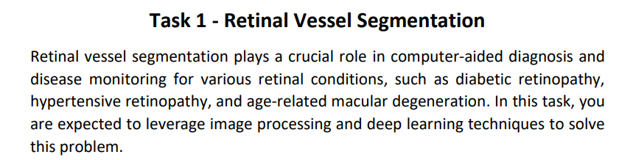
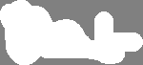

Slide 3
Data

Slide 4
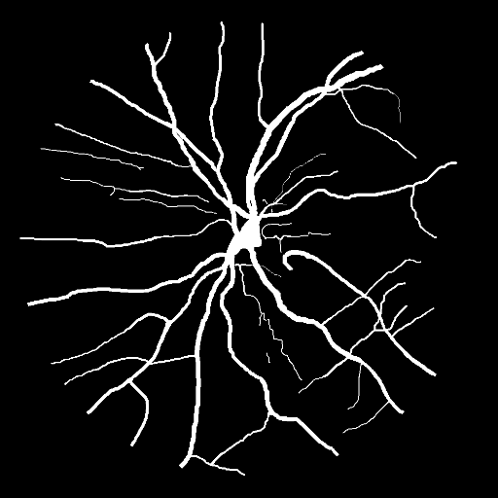
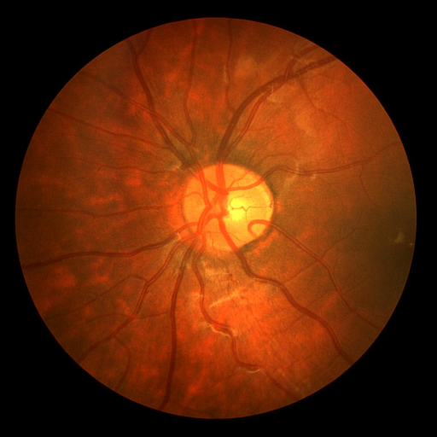
The dataset provided consists of the following folders/files:
Retina: contains the original retinal scan images.
Mask: contains the corresponding ground truth mask for each image in the retina folder.

Slide 5
retina
mask

Slide 6
Preprocessing

Slide 7
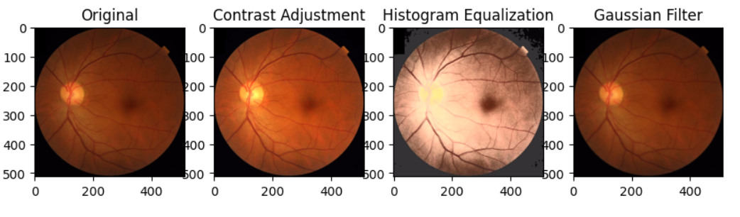

Slide 8
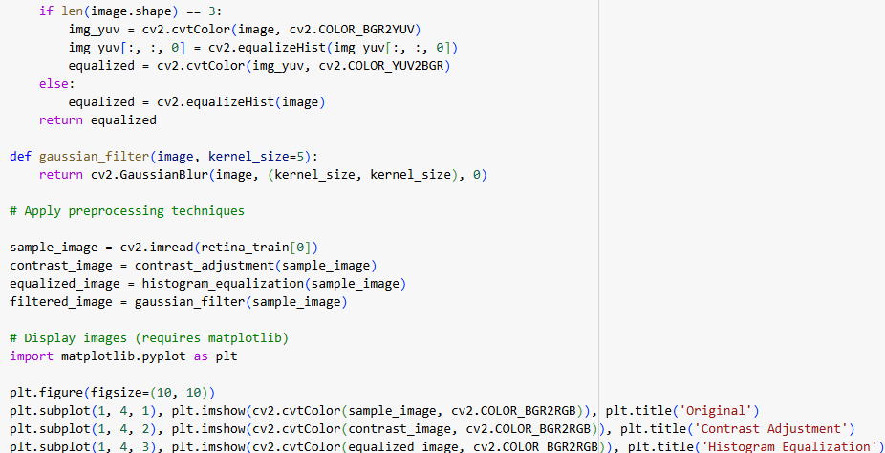

Slide 9
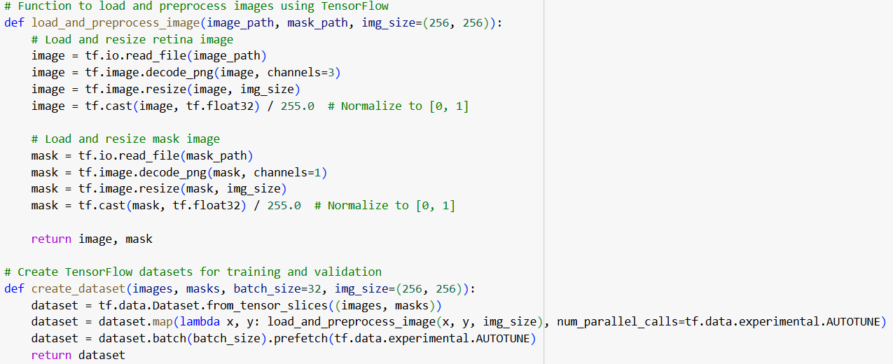

Slide 10
Model

Slide 11
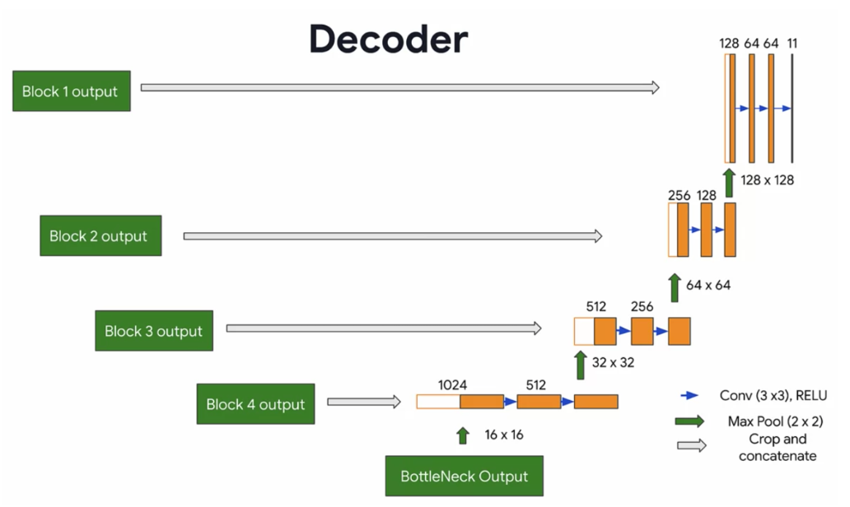

Slide 12
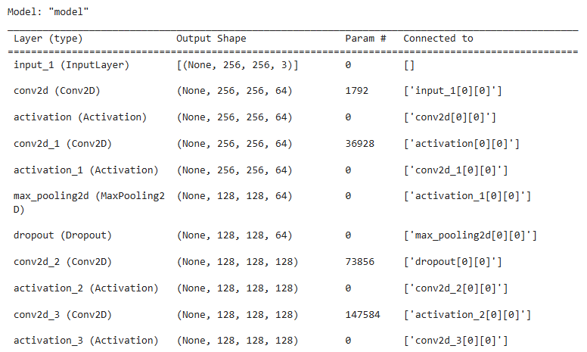
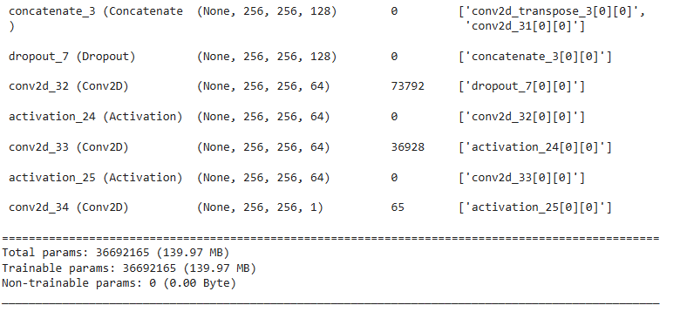
Total params: 36692165 (139.97 MB) Trainable params: 36692165 (139.97 MB) Non-trainable params: 0 (0.00 Byte) ______________________________________

Slide 13
Evaluation

Slide 14
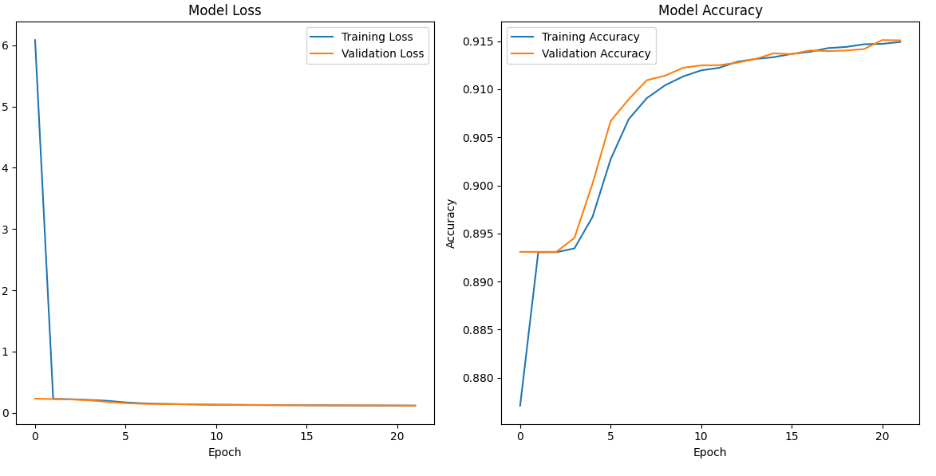

Slide 15
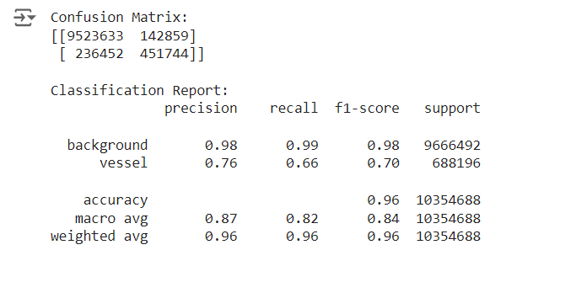

Slide 16
Results

Slide 17
